Slide 1
PRAYAS 2020 A NUMERICAL BASED ALGORITHM ON CRYPTOGRAPHY USING IMAGE PROCESSING PRESENTED BY SOURADEEP DAS FROM RCC INSTITUTE OF INFORMATION TECHNOLOGY DEPARTMENT OF ELECTRONICS & COMMUNICATION ENGINEERING

Slide 2
INTRODUCTION
In the 21st century security and privacy for a digital data to be stored & transmitted become a major concern due to rise of internet & digital common devices. Information hiding is becoming very popular technique in terms of security & privacy for digital data. Among information hiding techniques cryptography is one of the well recognized one that enables the science of using mathematical study to encrypt and decrypt data. Cryptography enables us to store sensitive information or transmit it across insecure networks so that it cannot be read by anyone except the intended user. There are several major applications of cryptography is as well, starting from protection of sensitive information of personal data security to diplomatic & military communications security. There are also many aspects to security and many applications, ranging from secure commerce and payments to private communications and protecting health care information as well. Cryptography provides a range of effective solutions.
OBJECTIVE
Using of this cryptography algorithm for gray scale images to encrypt any gray scale image from being tampered or accessed by the unauthorized users. The basic objective is to develop an algorithm for safe and secure transmission of gray scale images & the making the algorithm as much sensible as possible from any kind of manipulation of the encrypted image and also achieving results from these two encryption and decryption processes as fast as possible.

Slide 3
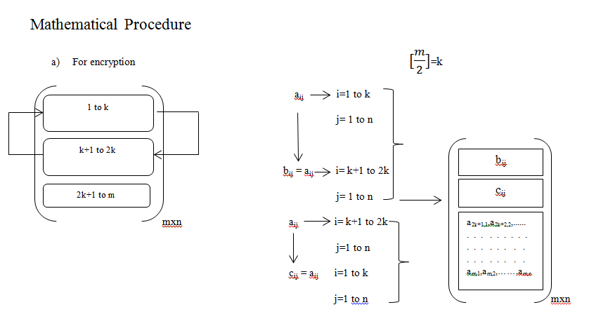
ENCODER
The encoder is used for encryption of the gray scale images. Here a gray scale image is used for the encryption purpose. The method of encryption is shown below.
The encoder performing row transformation

Slide 4
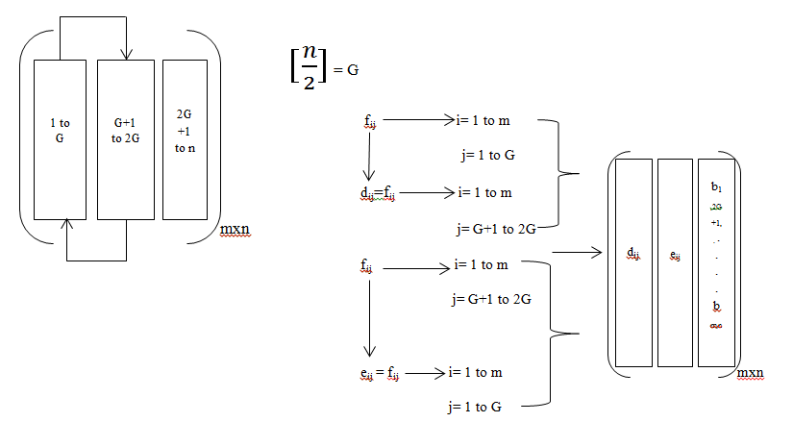
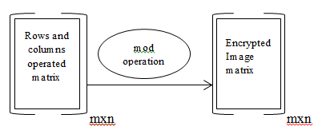
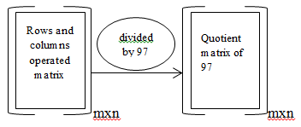
The encoder performing column transformation
After transformation of the rows and columns the modulation operation is used for proper information hiding. The process is shown below.

Slide 5
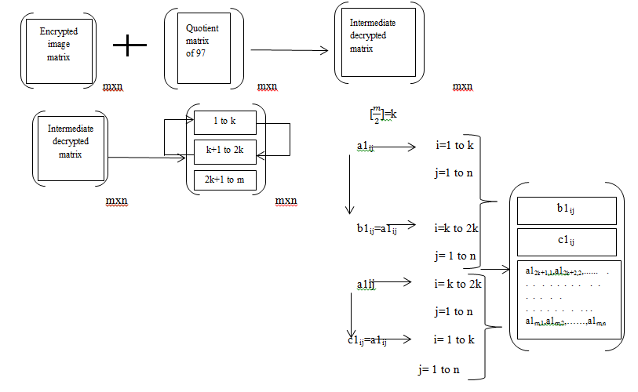
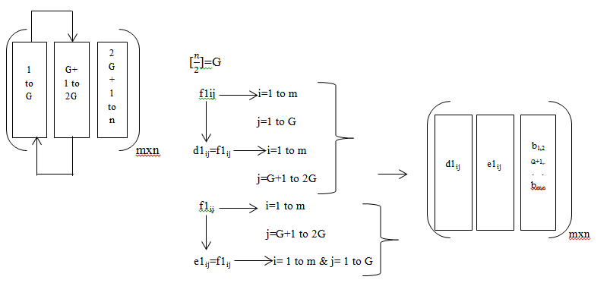
DECODER
In the decoder the decryption process starts by generating the crucial quotient matrix to an intermediate matrix by multiplying it with 97 and adding it with the elements of the encryption matrix. The intermediate matrix contains all the information with the accurate data which has been encrypted but in a transformed row and column form. Then again the transformation of rows and columns both are performed by the decoder one by one to get back the original image.

Slide 6
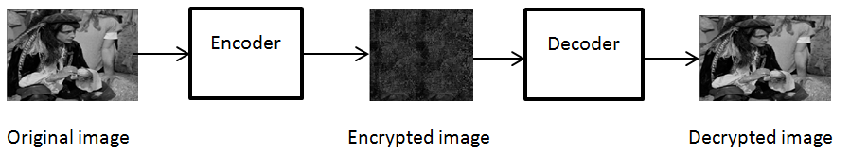
RESULT & DISCUSSION
This algorithm has been developed in Scilab software. The algorithm is simple but very fast while carrying both the encryption & decryption operations. The figure below shows the encryption and decryption procedure of the algorithm.
The encryption image is so sensitive that if any kind of alteration or manipulation is attempted then the entire data will be lost permanently, which makes the algorithm more sensitive. The above described algorithm is very much faster as well, having done the entire operation at an average time of operation is approximately about 0.2658ms. This is the average time that has been taken for both encryption & decryption by the entire algorithm. The main aim is to protect the information or can also be demonstrated as hiding the data for safety or security .This algorithm is for any type of two dimensional matrices .We used a gray scale image to demonstrate the effectiveness, reliability and flexibility of the algorithm.

Slide 7
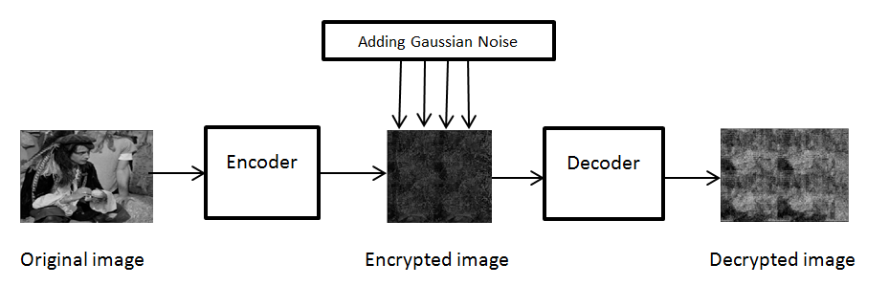
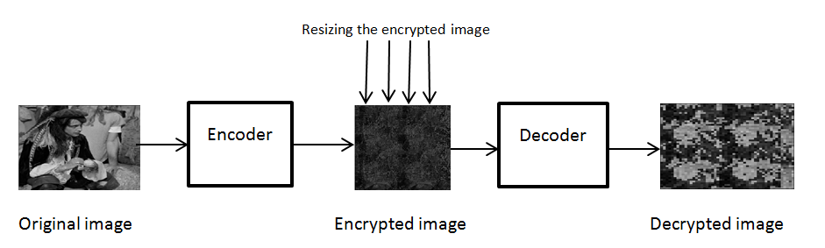
In this slide there are some manipulations which are performed on the encrypted image and after that even after applying proper decryption process the original image is completely lost.
The above results show that any kind of attack on the encrypted image will result permanent loss of the image & clearly shows the security and the sensibility of the algorithm

Slide 8
CONCLUSION
This work of gray scale image encryption, which demonstrated an efficient as well as secured algorithm for protection and transmission of data. It has been observed that the algorithm is capable enough to execute proper and efficient image encryption which will further protect the information from unauthorized users. After proper and desired encryption the algorithm is also capable enough to decrypt the exact original data from the encrypted data. There is no loss of information if proper decryption process is applied on the encrypted data. Even if any other decryption process is applied other than the actual decryption operation the algorithm is efficient enough to provide incorrect or inappropriate information and is capable enough to hide the actual information. It has been observed that if the encrypted information is processed by implementing any other operation or if the encrypted information is disturbed by any operation like cropping the encrypted data, resizing the encrypted data or by adding noise to the encrypted information it is impossible to get back the decrypted original data by using the proper decryption process. This makes the algorithm much more efficient when security issues are concerned.
FUTURE SCOPE
This algorithm can be further developed for encryption of colour images that will make this purpose of using this algorithm even more and can be used for further advanced data for secure transmission.

Slide 9
REFERENCE
[1] N. Sharma , Prabhjot and H. Kaur, "A Review of Information Security using Cryptography Technique," International Journal of Advanced Research in Computer Science, vol. 8, no. Special Issue, pp. 323-326, 2017.
[2] B. Preneel, Understanding Cryptography: A Textbook for Students and Practitioners, London: Springer, 2010
[3] J. Katz and Y. Lindell, lntroduct:ion t:o Modern Cryptography, London: Taylor & Francis Group, LLC , 2008.
[4] S. J. Lincke and A. Hollan, "Network Security: Focus on Security, Skills, and Stability," in 37th ASEE/IEEE Frontiers in Education Conference, Milwaukee, 2007.
[5] O. O. Khalifa, M. R. Islam, S. Khan and M. S. Shebani, "Communications cryptography," in RF and Microwave Conference, 2004. RFM 2004. Proceedings, Selangor, 2004.
[6] Manajaih DH. Modular arithmetic in RSA cryptography. International Journal of Advanced Computer Research. 2014; 4(4):973-8.
[7] N. Jirwan, A. Singh and S. Vijay , "Review and Analysis of Cryptography Techniques," International Journal of Scientific & Engineering Research, vol. 3, no. 4, pp. 1-6, 2013 .
[8] Khanapur NH, Patro A. Design and implementation of enhanced version of MRC6 algorithm for data security. International Journal of Advanced Computer Research. 2015; 5(19):225-32.
[9] Hassan MF. Synchronization of hyperchaotic systems with application to secure communication. In IEEE international systems conference (Sys Con) 2015 (pp.121-6). IEEE
[10] J. Callas, "The Future of Cryptography," Information Systems Security, vol. 16, no. 1, pp. 15-22, 2007.

Slide 10
THANK YOU

